Slide 1

Jam Jar
Notes:
Hi am Alec from Alectronic. and I am here today to talk about Jam Jar.

Slide 2
Jam Jar
Online Market stall platform.
For Market stall Vendors selling:
Jams, Honey, Chutneys, Oil, Yogurts, Tea,
Baked goods, Chocolates, bottled smoothies & juices
Beers, Ciders, Spirits, Wines
To Sell online to
Customer
Wholesale Customer i.e.. Restaurants, Local Shops
Order from multiple stall vendors in one go.
Notes:
Jam Jar is an on-line E-commerce platform for local farmers market producer. To sell to Customer and local restaurants and Shops (In Bulk).

Slide 3
The Problem
Market are static location and Time.
Don’t know if your doing oversell undersell for a day.
Not everyone can get to a Market on the day.
Notes:
The problem with Market stalls are they are static... In both Time & Location.
So they dratically reduce there market size.

Slide 4
The Solution
Online Mobile Platform running (24/7)
Allow customer to order online to pick up at market or get delivered.
Get an indication of who is ordering your stock.
Create an online identify of your business.
Notes:
Jam Jar solves this by putting your business online and running 24/7 and allow customer to order and pre-order your stock to either be picked up at the market or delivered straight to there doors creating convince for both customers and market stall owners. This also will help Marketstall owners to get an indication of how much stock they sell and help reduce over and under stock at markets.

Slide 5
The Minimum Viable Product
An Ecommerce platform
To sell Market stall produce
Profile page for market stalls.
To get online recognition of the business
Notes:
But we also think it important that your business still has the same effect as the farmers market so we also include in the Minium VIable Product a profile page for your prdocut so customer know who they are buying from with more feature to be added in later development.

Slide 6
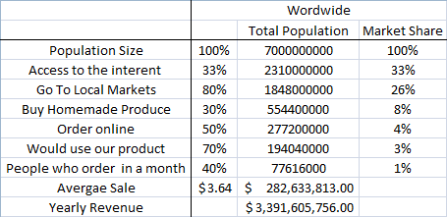
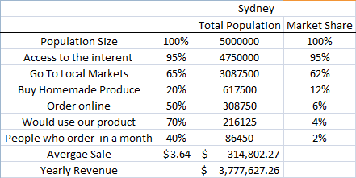
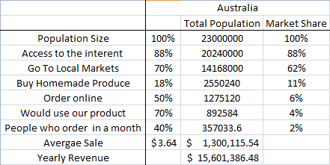
Market Analysis
Notes:
From my market analysis about 200 Thousand people would use this product within Sydney alone. with a estimated revune per sale at about 3dollars 64cents in a year Jam Jar could earn 3.7M just in sysdney.
Times that by the world it goes up to 1000x to about 3.3Billion.
This is all asumptions but my belif is that a trend will come from this with the convenience of ordering online and the wants of customer to support local business this will gradual grow over time.

Slide 7
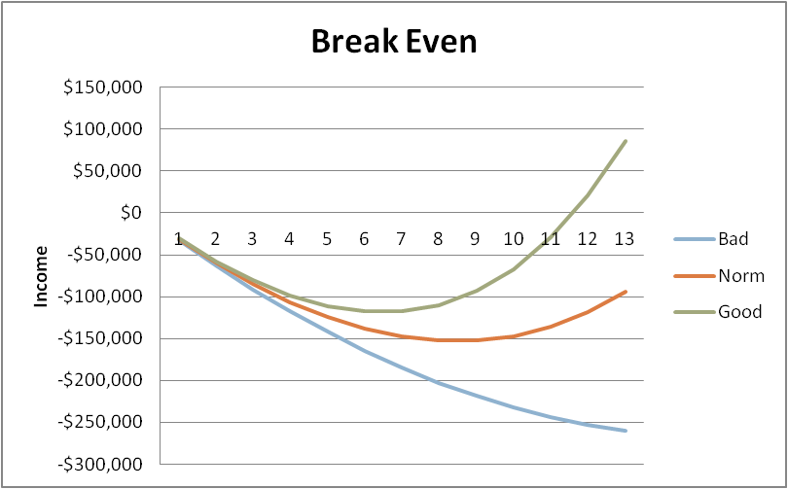
Financial Forecast
Notes:
my forecast projection also indicate that if the launch is successful that we could break even by the end of the year. this is not taking into account pre-launch cost.

Slide 8
The Phase
One
Two
Growers
Market
Customer
Wholesale Customer
Notes:
Now once the launch has been successful Jam Jar can look toward the next phase which is getting the customer to become not only to the consumer by also the grower for the local farms markets.
We want to create local suitability with in local community by getting people to also grow part of what the market stall sells. This would reduce cost, reduce carbon emission and inject more money into local business.

